Slide 1

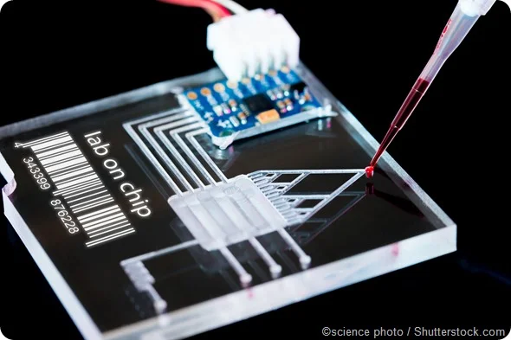

Team 78: Interdigitated Electrodes in Droplet Microfluidics
Bi-Weekly Update 5 Erin Ingram and Omar Mahmood Sponsor: Dr. Arum Han, Dr. Han Zhang TA: Dalton Cyr
Notes:
Omar

Slide 2
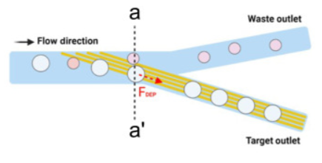
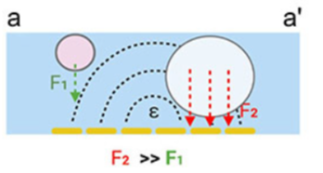
Project Summary
Mitigating satellite droplets in microfluidic “lab-on-a-chip” devices that lead to false test results in drug screenings, disease diagnostics, DNA analysis applications
Using interdigitated electrodes (IDEs) to perform size-based filtration on microfluidic droplets
Notes:
Omar

Slide 3
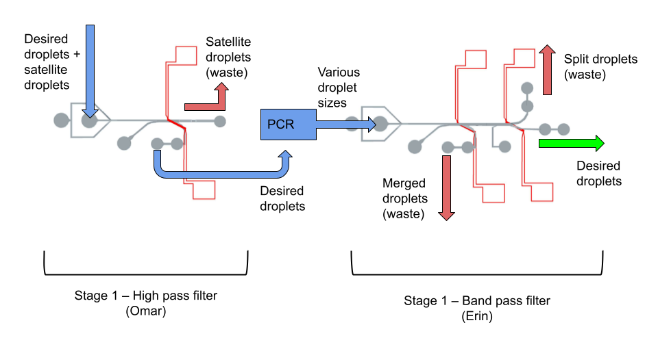
Project/Subsystem Overview
Notes:
both

Slide 4
Project Timeline
Fabrication
Preliminary Validation
Experiments & statistical analysis
Component Optimization
Validation of whole device
High level figure showing where you are at in the project, what’s completed, what’s underway – it should take about 30 seconds to summarize where you are in the timeline
-- Save discussion for subsystem update
-- Save detail for execution plan & validation plan status
Fabricated High Pass Filter
Fabricated Band Pass Filter
Fabricated IDE’s
No leakages or blockages
High Pass filter sorts within acceptable range
Band Pass filter sorts within acceptable range
Test different voltages
Test different IDE parameters
Use image processing software
Refabricate IDE’s if needed
Design new channels if needed
Decide on IDE parameters
Run whole system together
Test droplet maneuverability between filters
Notes:
erin

Slide 5
Fabrication
Erin
Accomplishments since last update: 15 hours of effort | Plan for next 2 weeks:
Passed check-off trainings for EVG 610 Mask Aligner and Bidtec Spin Coater Fabricated new IDEs (5, 10, 20 um) Trained on PVD 75 Electron Beam Gun tool – gold deposition Worked on thesis | Meeting with postdoc tomorrow to review thesis Statistical analysis
Notes:
erin

Slide 6
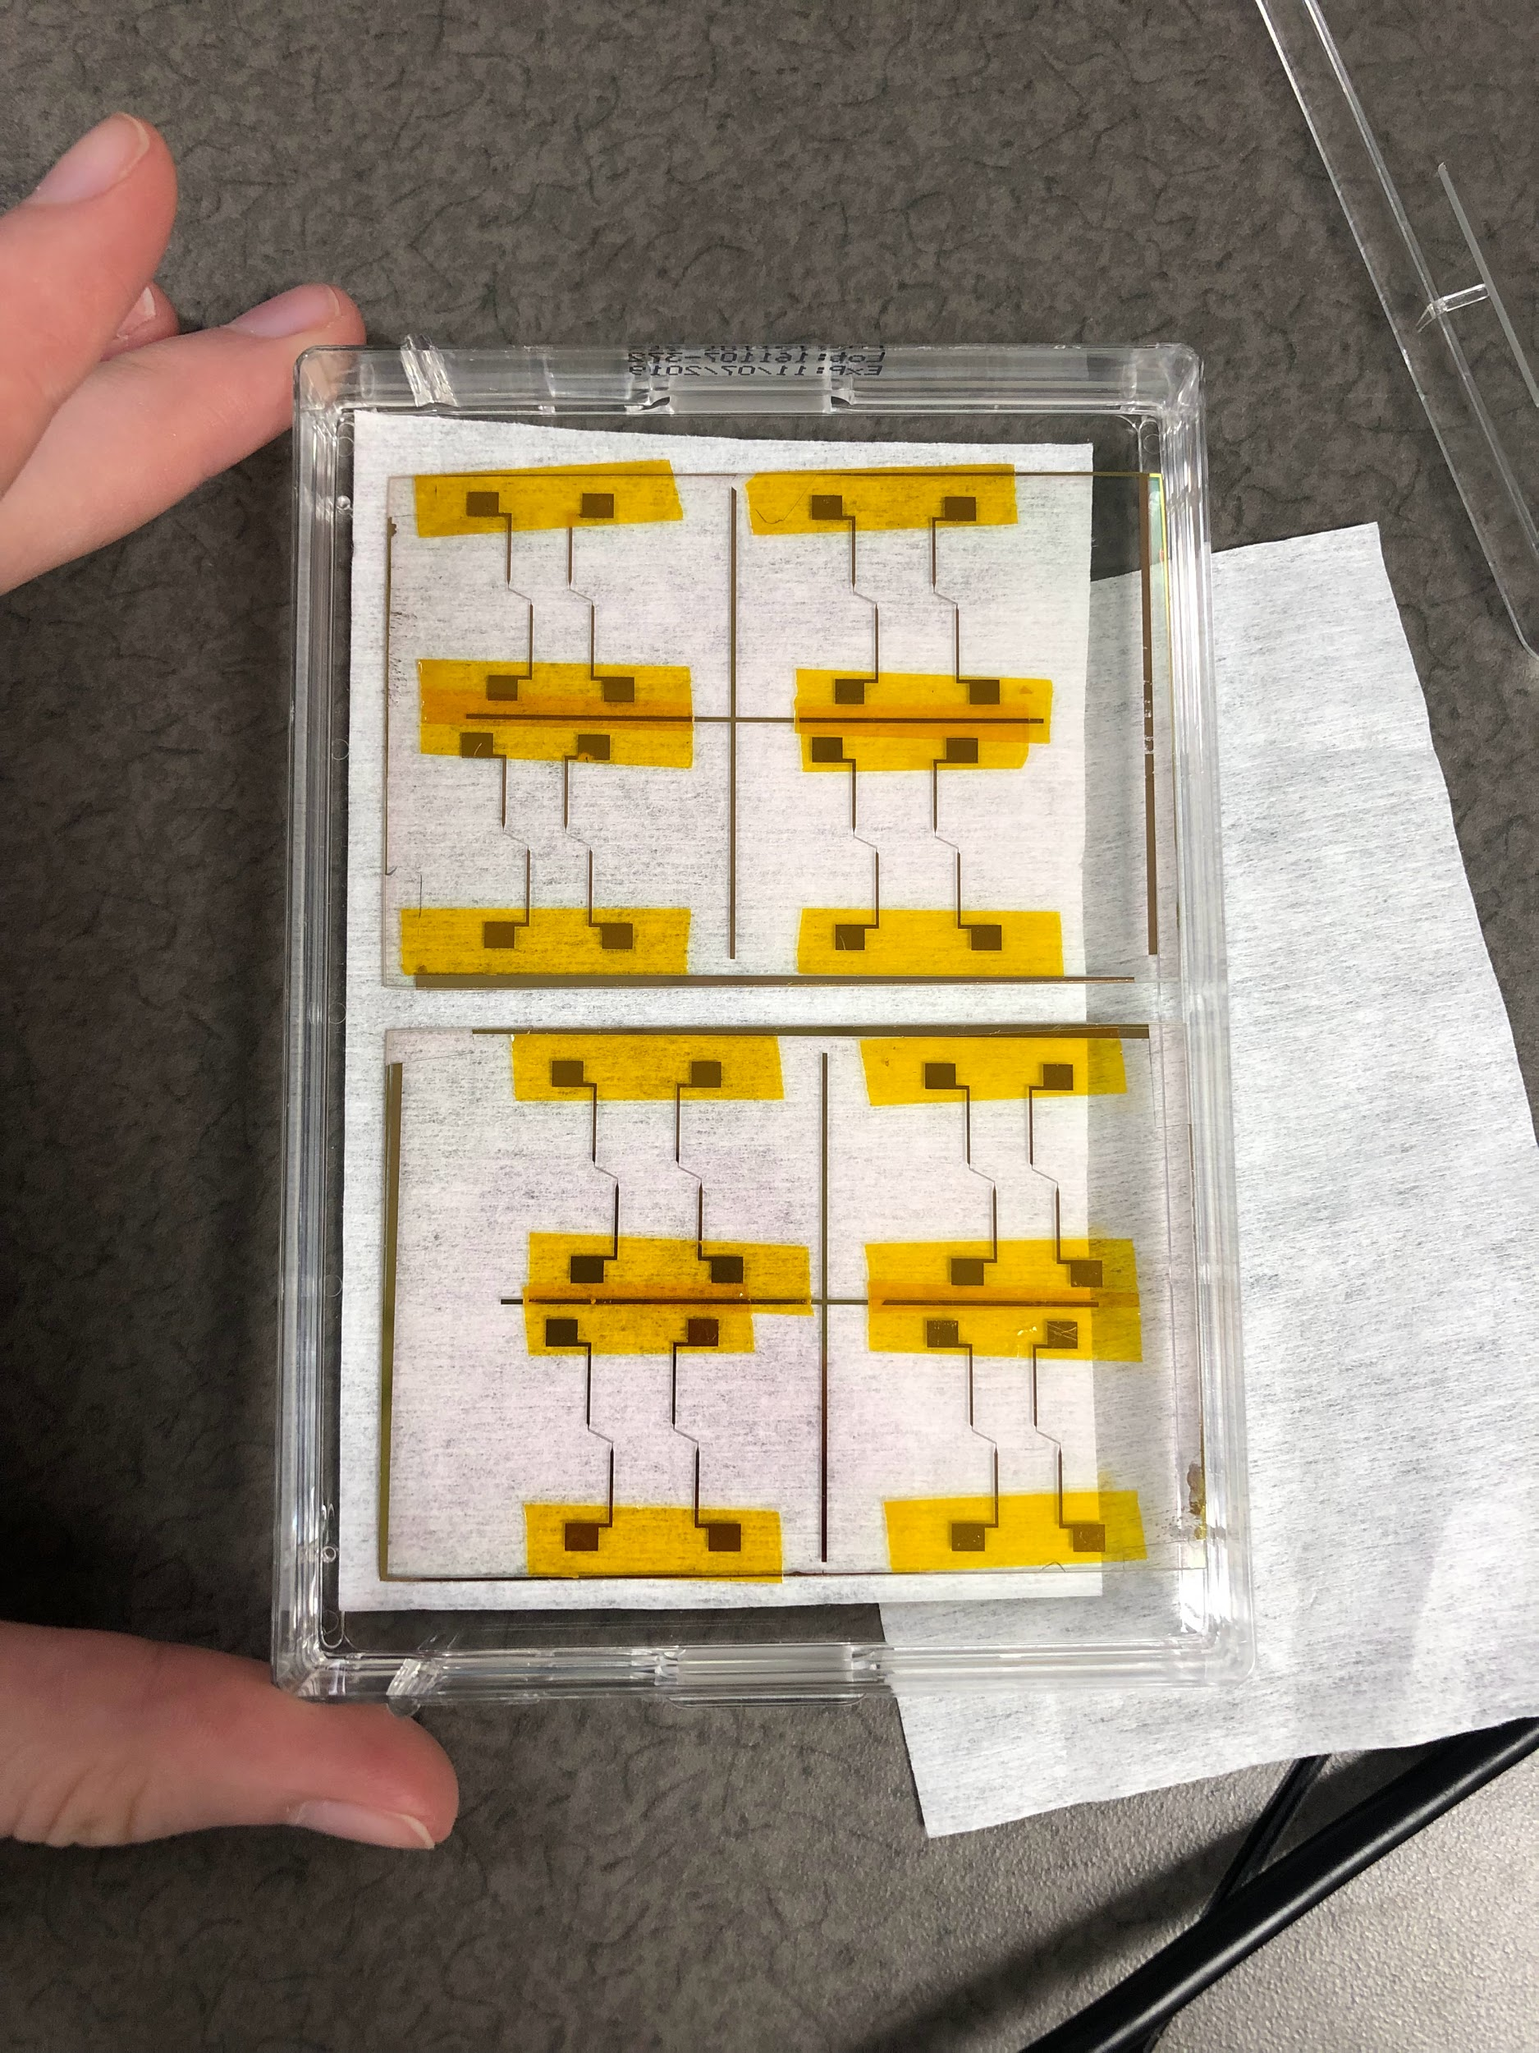
New IDEs

Slide 7
Experimentation
Omar
Accomplishments since last presentation 12 hrs of effort | Ongoing progress/problems and plans until the next presentation
Fabricated channels for IDE slides Experimental design for second set of experiments Worked on thesis installments | Run phase 2 of experiments -Testing different IDE parameters Meet to review thesis
Notes:
omar

Slide 8

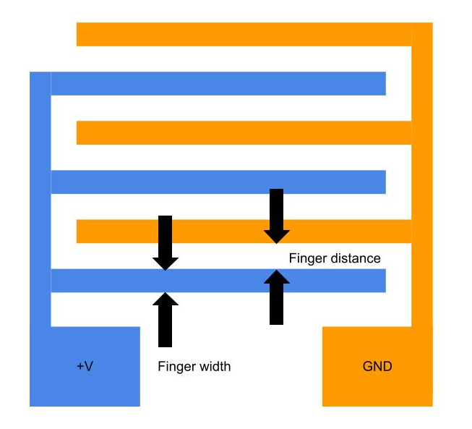
Experimental Plan
IDE size/spacing
SCHEDULED FOR MONDAY 3/27/2023
Simpler experimental plan
Test filtration using 5um, 10um, 20um IDEs
Hold voltage constant at 0.15 V
Notes:
omar

Slide 9
Execution Plan
Date | Accomplishment
February 22 | Complete image processing on our previous experiments At least one experiment
March 8 | Continue experiments
March 29 | Continue experiments
April 5 | Image analysis on all experiments Thesis final installment
April 19 | Finalize optimal device design
May 3 | Validation of entire system
Notes:
erin

Slide 10
Validation Plan
Things we need to do: | Progress | Subsystem
Image processing on preliminary validation experiments |  | Both
Voltage experiment: 0.7V |  | Both
Voltage vs Flow Rate experiments |  | Both
Droplet size vs Threshold voltage experiments |  | Both
IDE experiment: 5um |  | Both
IDE experiment: 10um |  | Both
IDE experiment: 20um |  | Both
Image processing on all voltage and IDE experiments |  | Both
Determine best voltage & IDE combo |  | Both
Final experiments with best parameters |  | Both
Notes:
erin

Slide 11
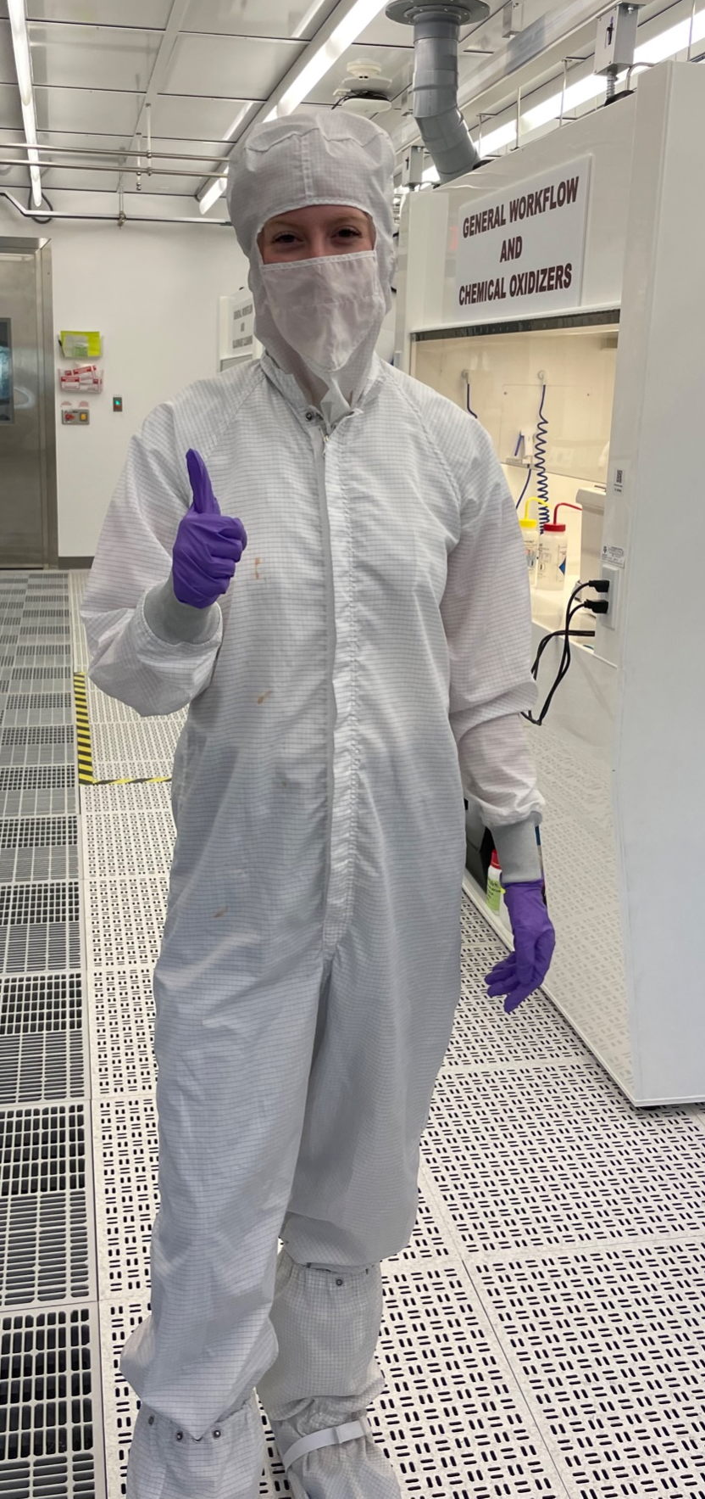
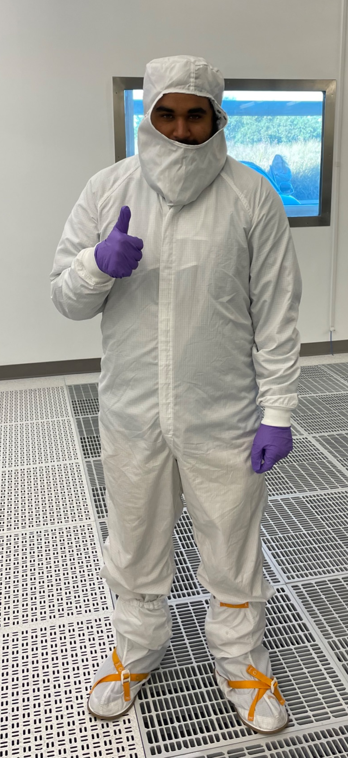
Thanks!
Any questions?

